Slide 1


Yelp Academic Data Analysis
GROUP 10 - BIG DATA PROJECT
GROUP MEMBERS:
MANASA BELLAMKONDA
PRACHI GUPTA
PRIYANKA SARIYA

Slide 2

Introduction
Business Problems :
Perform Analysis on Yelp Academic Dataset
Perform Visualization, Graph Mining and create graphs on Yelp data
Model the data with various techniques and interpret the output
To perform sentiment analysis on Review dataset of Yelp

Slide 3
Dataset Description
Datasets
The dataset contains files of Businesses, Reviews, User data, Tips and Checkin Data.
For our analysis, we have used two dataset: Business and Reviews dataset. Following are the main columns in these datasets:
Business Dataset:
Business Id, Name of Restaurant, Address of Restaurant, Lat-Long values, Star Rating, Review Count, categories of Restaurants, Open Hours, City, State
Review Dataset:
Review Id, User Id, Business Id, Star rating, Date of Review, Review Text, Attributes (Useful, Funny, Cool)

Slide 4
Dataset Cleansing
The Yelp dataset had millions of rows. SEMMA (Sample, Explore, Modify, Model and Assess) method is followed to obtain a sample of dataset
We have filtered the dataset in Pyspark to reduce the dataset to only one (Phoenix) city and perform the analysis on the same
The cleansing is also performed in Pyspark:
To remove unwanted columns
To impute the null values with zero values
To remove the Outliers
To convert the strings into Numerical values to input these values in models

Slide 5
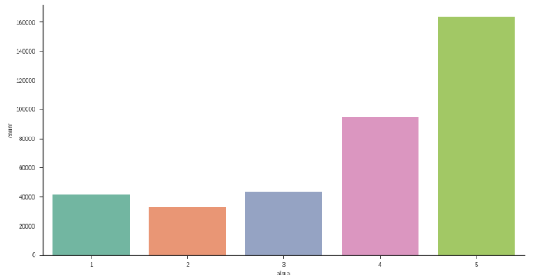
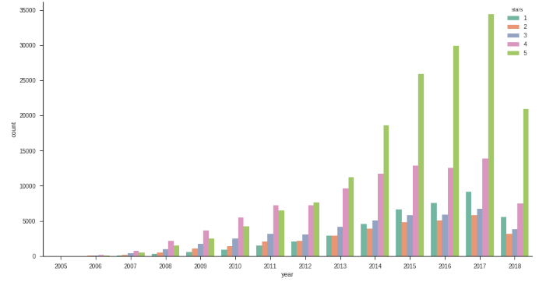
Analysis: Part 1
We have tried to perform Visualizations and create various graphs on different columns and analyze these graphs
Count of restaurants for each star rating Count of restaurants based on star rating in each year
We can see here that mostly the restaurants in Phoenix are rated with star rating 4 and 5
This graph shows, that in 2017, highest number of restaurants are rated as 5, and there is an incremental trend in restaurants and rating from 2005 to 2017

Slide 6
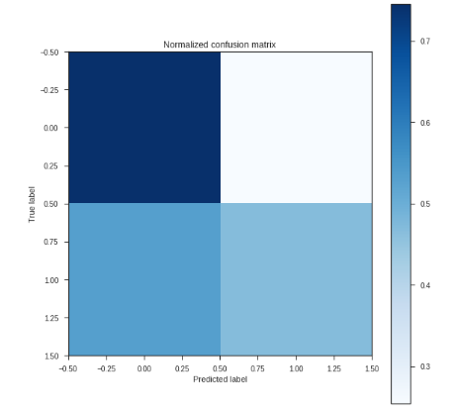
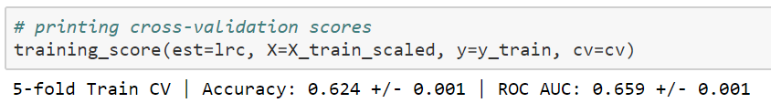

Analysis Part 1
Model:
One of the models that we have performed is Logistic Regression model after dividing the data in training and test dataset.
This is to predict the star rating of a restaurant.
Calculating the scores which gives accuracy of the model and Receiver operating Characteristic
Confusion matrix:
We normalized the confusion matrix before running the model to calculate prediction accuracy via Confusion Matrix
The Confusion matrix is giving us the values of True Positive, True Negative, False Positive, False Negative

Slide 7
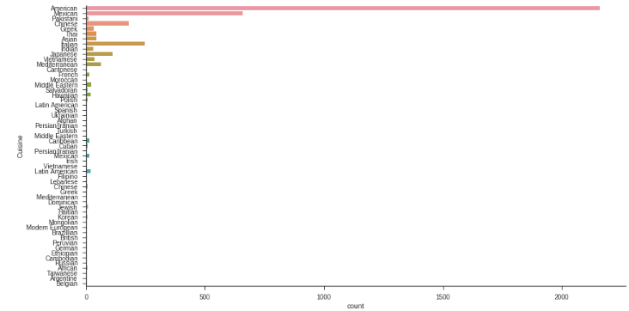
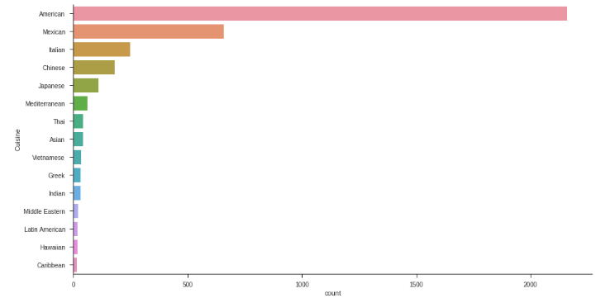
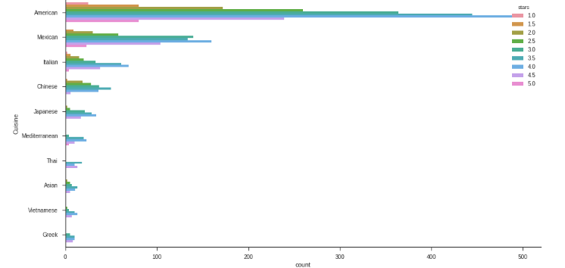
Analysis Part 1
Cuisine Analysis: We cleansed the column of Categories to find the Cuisine that is served in each restaurant in Phoenix
1) Plotted the most popular cuisines in Phoenix across all the restaurants
2) Plotted the count of Top 15 cuisines in Phoenix across all the restaurants
3) Plotted the Top 15 cuisines with their count as per the star rating in the state of Phoenix

Slide 8
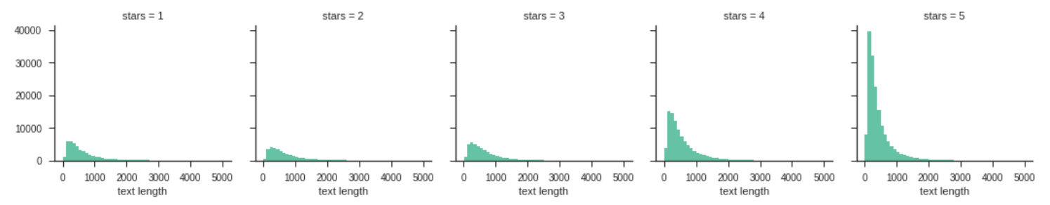
Analysis Part 1
Review Analysis: To analyze the text of review and predict star rating based on positive and negative review
To start with, we calculated the length of each review text and created a new column of the same
We have used Seaborn to create graphs of review analysis
We have used FacetGrid attribute to see if there’s any relationship between new columns text length and the stars rating
Interpretation: The distribution of text length is similar across all five ratings. However, the number of text reviews seems to be skewed a lot higher towards the 4-star and 5-star ratings.

Slide 9
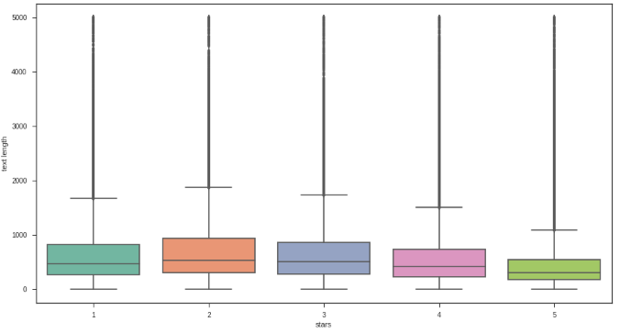
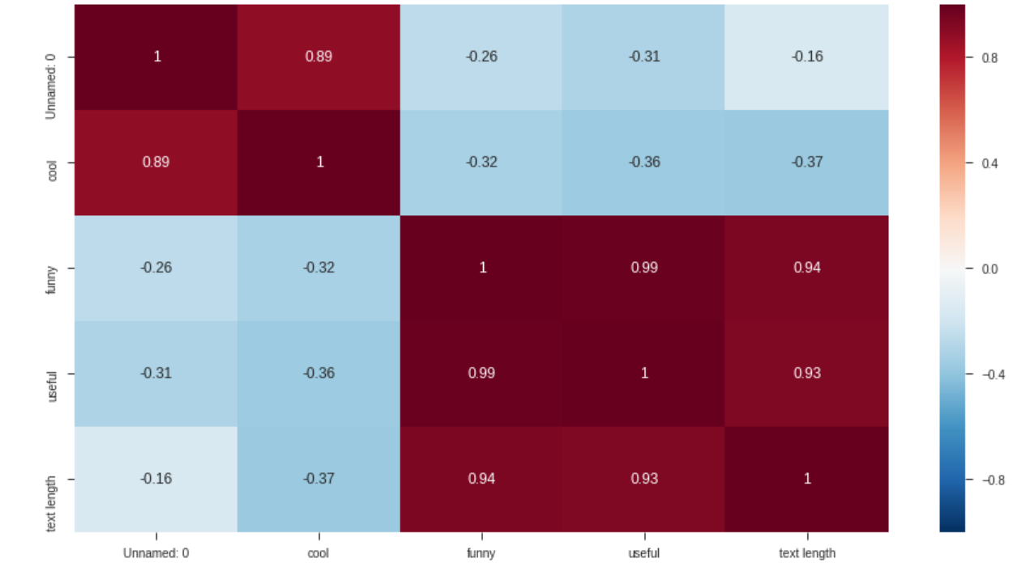
Analysis Part 1
Review Analysis: To analyze the text of review and predict star rating based on positive and negative review
Creating Boxplot for each star rating using matplotlib
Created a Correlation matrix of the features
Interpretation: From the plot, it is visible that the 1-star and 2-star ratings have much longer text, but there are many outliers which are visible above the boxes. Because of this, maybe text length won’t be such a useful feature to consider after all.
Interpretation: Looking at the correlation map of features, it seems funny is strongly correlated with useful & useful is strongly correlated with text length. We can also see a negative correlation between cool and the other three features. Now, for positive and negative review analysis, we will use the reviews with star rating 1 or 5.

Slide 10
Analysis Part 1
Review Analysis:
To perform this, we downloaded the stop words from NLTK library, and created a function to run following actions;
Converting the statements into Individual words
To remove stop words from statement
To remove Punctuation
To return the clean text after running all the above actions
After this, we divided the data into Training and Test dataset and ran Multinomial naïve bayes Theorem, to predict the rating of a positive or negative review.

Slide 11
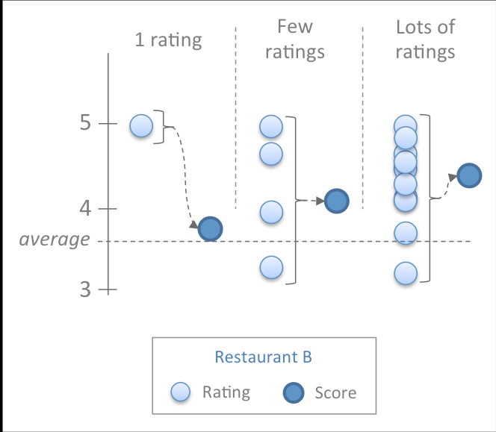
Analysis Part 2
Ranking a Restaurant
Now, the number of reviews for each restaurant is different, and so are the star ratings. We cannot rank restaurants simply based on their number of reviews or the stars received. Some restaurants have received 5 stars, even though they have just 1 review and some have received 3 stars with 500 reviews. So, to solve this problem we'll be calculating the ranking as follows
S = (w * R) + ((1 - w) * C)
w = v/(v+m)
where
S = score of the restaurant
R = average of user ratings for the restaurant
C = average of user ratings for all restaurants
w = weight assigned to R and computed as
v/(v+m),
where,
v = the number of user ratings for that restaurant,
m = average number of reviews for all restaurants.
When there are a lot of ratings for a restaurant (large v), w gets close to 1 and the score pays more attention to R rather than C. On the contrary, in a restaurant with a few ratings, v becomes small and w gets close to 0, which implies that the score places a lot of weight on C.

Slide 12
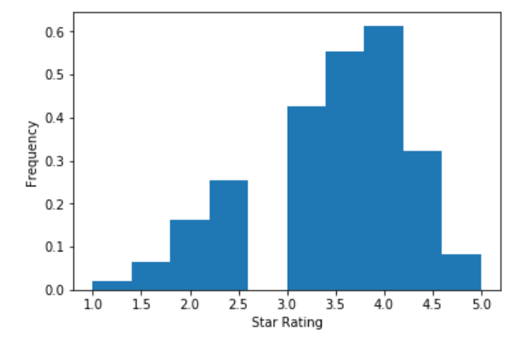
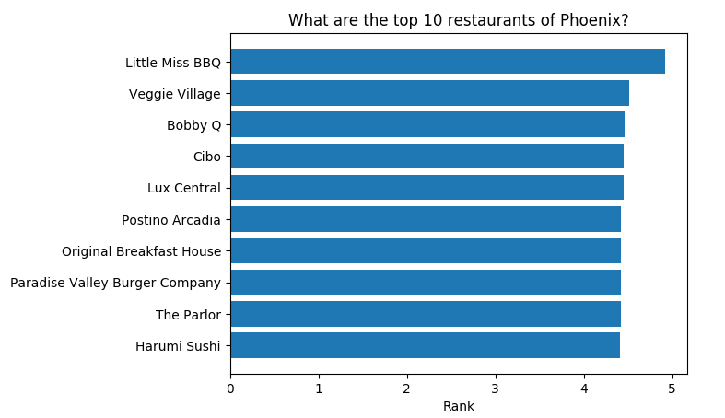
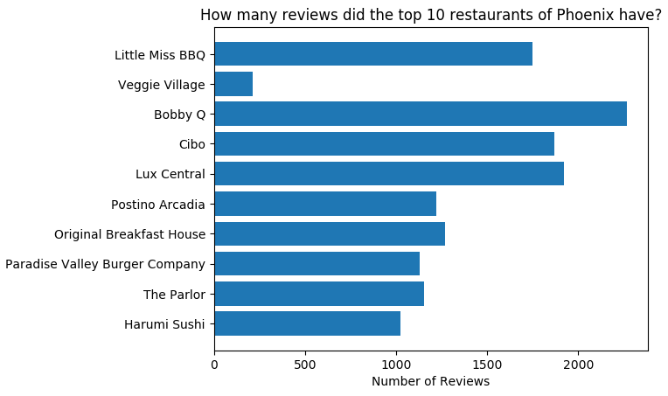
Analysis Part 2
Frequency Analysis:
For this, we have used SQLContext to run the queries and matplotlib to create Histograms on Phoenix dataset:
Histogram on count of Restaurants for each star
A bar graph to rank the Top 10 Restaurants in Phoenix
A bar graph to show the count of reviews of these Top 10 Restaurants

Slide 13
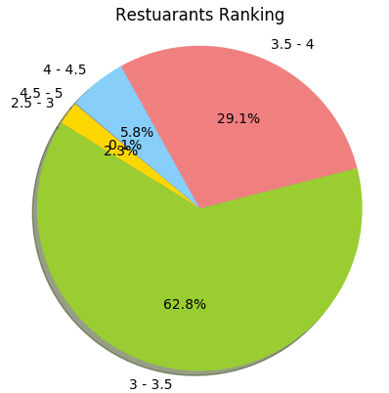
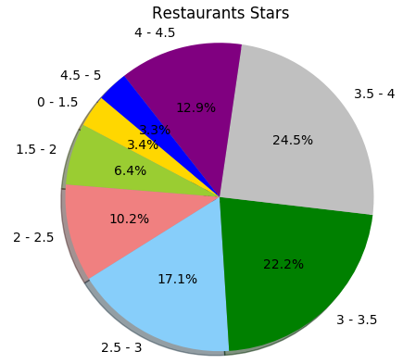
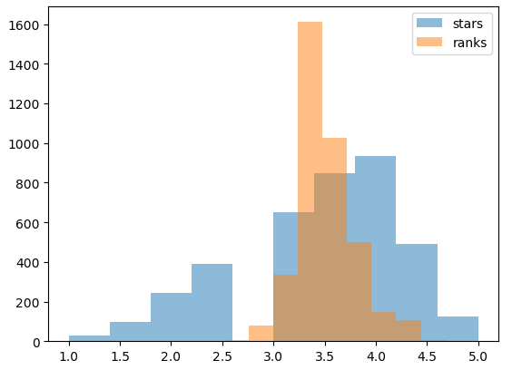
Analysis Part 2
Pie Charts & overlapping Histograms to compare ranks from stars
Interpretation: Because ranking Ranking is a better way to understand the position of a restaurant among all the restaurants

Slide 14
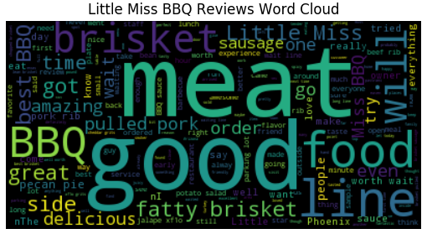
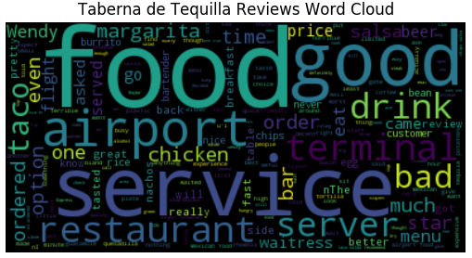
Analysis Part 2
Word Cloud
Using the Review dataset, Word Clouds were created. Word Clouds for top tanked and lower ranked restaurants were created.
Interpretation: We see that there are lot of positive words in a good rated restaurant and lot of negative words for a lower ranked restaurant

Slide 15

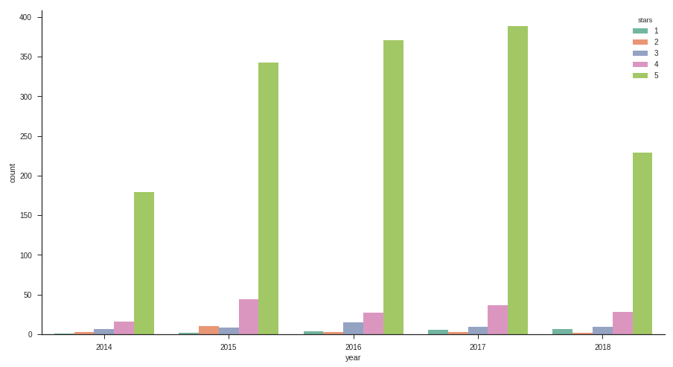
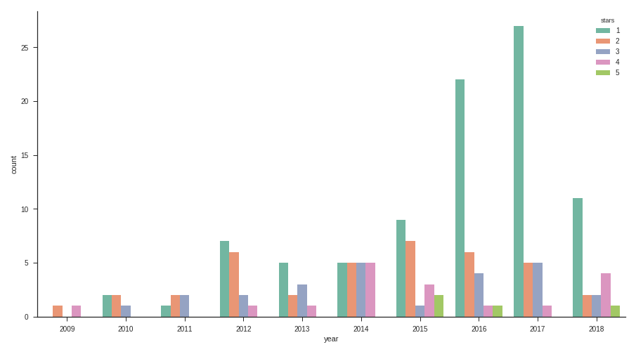
Analysis Part 2
Graph to plot the ratings of restaurants in the past 10 years
We have devised a sequence of ratings over the past 10 years for 2 restaurants
Little Miss BBQ
Taberna de Tequilla.
Little Miss BBQ
Taberna de Tequilla
We see that Little Miss BBQ joined Yelp only in 2014, and it has always had lots of 5 star ratings from reviewers.
For Taberna de Tequilla, since 2009, we see that it rarely gets 5 star ratings and most of its ratings are 1 star.

Slide 16
Analysis Part 3 -Modelling
Model Creation :
Challenge was to find the suitable model to suit the data.
Logistic Regression
LinearRegressionwithSGD ( Stochestic Gradient Descent)
Variable Distribution:
Dependent Variable (Y): - Stars;
Independent Variables (X): - Longitude, Latitude, Review_Count
Best Model:
Logistic Regression: Accuracy of 62%
LinearRegression : Accuracy of 98% (in comparison train and test data)
Reason to choose SGD:
With multiple iterations, the model gives an accurate estimation converging the error close to Zero.

Slide 17
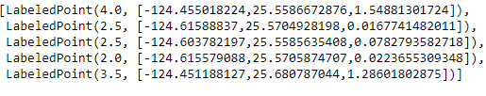
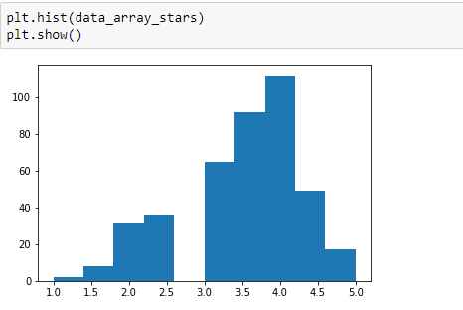
Analysis Part 3 -Modelling Linear Regression
Data Preparation :
Scope of Work: Numeric Variables of data
Create a RDD of Labelled Points
Data Distribution - Check if the Y variable is normally distributed, for any outliers etc
Best Pick Model:
Linear Regression Model :
The Y variable is continuous, normal distributed
Logistic Regression Model :
This is suitable for a Y variable with values 0/1

Slide 18
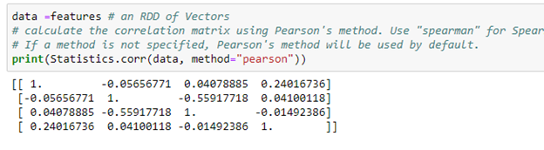
Analysis Part 3 - Modelling
Pre- Analysis:
Correlation Matrix:
Gives the correlation between the column variables
A value in between (-0.8, 0.8) shows no correlation and the variables can be used in the model
Our data variables do not show any correlation.

Slide 19
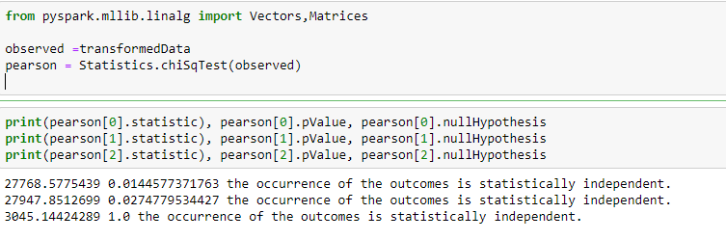
Analysis Part 3 - Modelling
Hypothesis Testing (Pearson’s Chi-Squared Test) :
This is a powerful tool in statistics which tells whether the chiSq test results are independent and have a Goodness Of Fit.
We can see the p-Value and the analysis if our model can accept or have to reject the null hypothesis

Slide 20

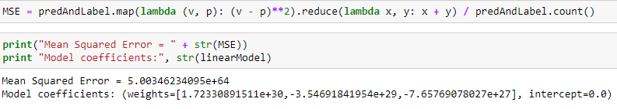
Analysis Part 3 -Modelling
Model Execution:
Model and Predict the Train Data
Calculate the various parameters from predictionsAndLabel RDD
Evaluate the parameters like R-Squared etc using Regression Metrics

Slide 21
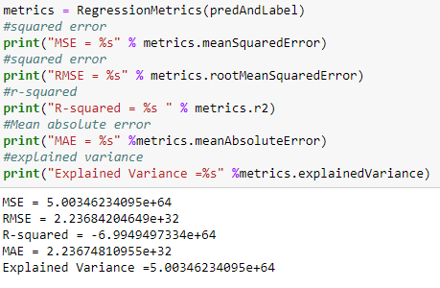
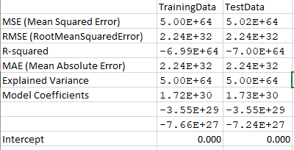
Analysis Part 3 -Modelling
Comparing all the evaluation metrics performed for training Data and test Data
We find that models of both the data and their predictions almost have the same values
Considering, the p-Value, we can say with 95% confidence that the co-efficients and the R-squared value of both the model predictions are similar, hence the models are accurate.
Looking into the parameters.

Slide 22
Issues Faced
Below are the list of challenges that we faced while working on the selected yelp dataset:
Spark’s main concept is Resilient Distributed Dataset (RDD), which runs on top of HDFS. Yelp dataset is huge (few GBs), we faced a big challenge in downloading this dataset from internet to the Cloudera VM.
Resolution: Downloaded the dataset on local machine, and mounted local folder with Cloudera VM folder.
Pyspark & python have many different forms of data types. Some functions worked with one type and not with the other. Also, some features were available with one type of data type, and not with the other. This created confusion and delayed our work to a larger extent.
The versions of many packages are outdated on the VM. Due to this, some functions didn’t work at all. So, pip install <[package_name> --upgrade were our rescue command. To look for answers online, we used various commands to find the version of the tools that we were using like Python, Spark, Jupyter Notebook, Pandas, This issue included the SparkSession feature, which is not part of currently available Spark in the VM, SparkSession is a latest feature and would have made our work much easier.
We tried implementing Linear regression model. The references procured from google, were not particular for the pyspark version 1.6.0 (the current version which we are using), hence a lot of effort went into finding the right commands for the version being used.
We faced a lot of issues in SqlContext, and have to move to other ways to perform the plotting as many commands do not work in SQLContext and it is the prominent way to put queries in the data.
The CountVectorization as required for Sentiment Analysis was performing extremely slow and did not work sometimes on our filtered dataset, this slowed our work to perform text analysis.
The system memory (RAM) was 8GB of 2 of our team members, which created issues with VM. They had to restart the VM and their computer time and again.

Slide 23
Future Use-Cases
Using Binaries: Our project has visualizations and different kinds of regression models. We could further pursue additional modelling using the Category and Attributes columns
We can create Decision trees to explore the data further and find significant variables.
Maps: Dropping pins in areas where the restaurants are could have helped in visualizing the map of restaurants.
To find how a neighborhood affects the restaurants ratings would have been an interesting topic to explore.
Sentimental Analysis: it is always interesting to know what kinds of sentiments a reviewer produced in their review. We had already created a heat map, but we wanted to add more work related to sentiments.

Slide 24
References
Internet was our go-to place to understand how to approach our hiccups in the project
https://www.yelp.com/dataset -- to download our academic dataset
To look up solutions and alternatives to our errors
https://stackoverflow.com/
https://github.com/
https://spark.apache.org/docs/1.6.1/api/python/index.html -- to refer to the existing functions and return values of these functions
http://www.ebc.cat/2015/01/05/how-to-rank-restaurants/ -- to find the formula to rank the restaurants of yelp
https://spark.apache.org/docs/1.6.0/api/python/pyspark.mllib.html#module-pyspark.mllib.regression - LinearRegression Model
https://spark.apache.org/docs/1.6.0/api/python/pyspark.mllib.html#module-pyspark.mllib.evaluation - To aid in the evaluation of the model
eBook
Frank Kane’s Taming Big Data with Apache Spark and Python, by Frank Kane

Slide 25
Thank You

